Slide 1
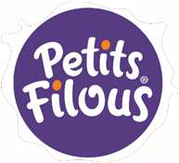



Nutrition | Healthy body / General wellbeing | Enjoyment | Mood changer
Healthy start – spoonable yogurt in poach pack with cereal flour (rice, oat and corn). | Low sugar/sugar replacement | Spoonable yogurt/fresh cheese with the layer of jelly on the bottom | Chocolate as a best treat (crackin shells)
Extension of fruit and veggie range with white carrot and sweet potato | Healthy kids formula - Vit D from Mushroom | Fruit shapes (soft inclusions) in spoonable yogurt | CO-branding “favorite tastes of animation movies heroes”
Milk – bar (could be with Probiotic granulates) Glazed yoghurt bar |  | Exploration of sensation in poach pack yogurt (cooling fresh, juicy sour, creamy velvet…..)
Yoghurts with fruit puree at the bottom. Clean label (CF)

Slide 2
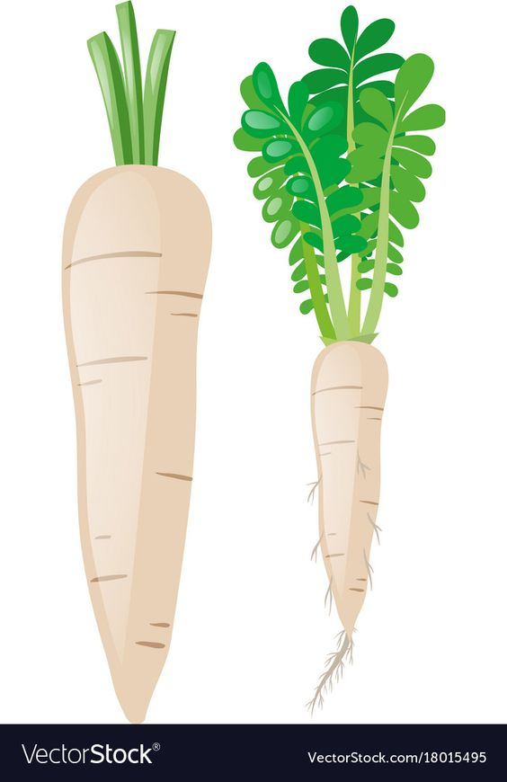
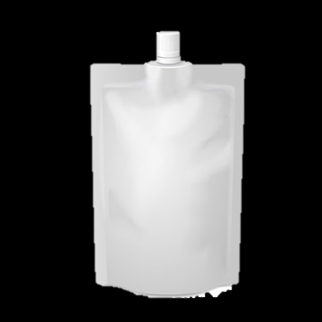
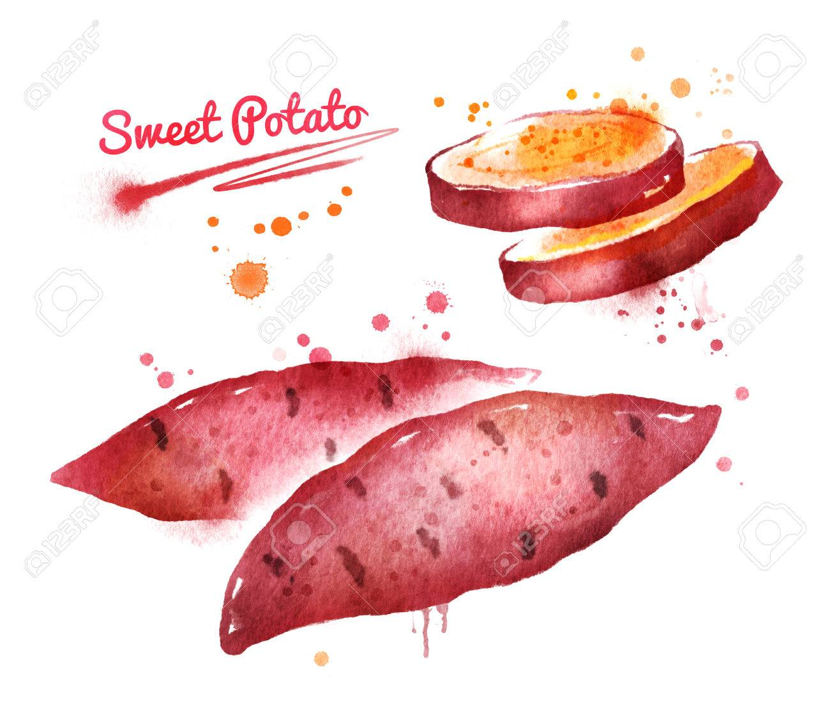

Company
FORCES
CHALLENGES
Clean label, no flavours/colors, no sugar added
There is no special adjustment required.
SOLUTIONS PROPOSEES
Invisible veggies! Natural formula of fruit and veggies compositions where you will not feel any taste of vegetables!
TIME TO MARKET
Sales model
< 6 months
B2B
Implementation costs
Facilite d’implementation
Existing packaging
Ingredients are known and used in dairy
Production solution
Economical performance
SUPPORT DE PRESENTATION CREATIVITY DAY
Sweet Potato Puree B94975 2,13 €/kg fût 200 kg MOQ 7T
Présentation: Y Prototypes/Maquettes: Y

Slide 3


Invisible veggies
The best range of fruit & veggies combination to provide the balance taste appreciated by kids
Product Value
Thanks to vertical integration Doehler is able to provide the best combinations of fruit and veggies for the creation of tasty and healthy product compositions for kids.
Reasony Why
Raising awareness of parents of the importance to introduce vegetables to kids’ diet
Introduction of vegetables to the food categories kids like (hidden introduction)
Combination with fruits will help to keep the main fruity tonality of the product.
Addressing younger target groups (young adults and kids).
Wide taste range available
OUR SOLUTIONS
Ingredient Systems & Natural Taste Solutions: Fruit- & Non-Fruit Preparations, Natural Flavours
Fruit and Vegetables:
Fruit and vegetable puree/juices

Slide 4
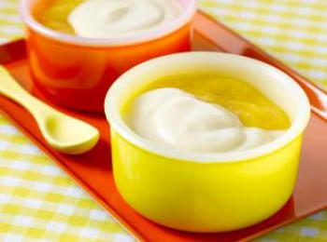
Company
FORCES
CHALLENGES
Clean label, no flavours/colors, no sugar added
There is no special adjustment required.
SOLUTIONS PROPOSEES
with
Fruit compote. Composition of fruit smooth compote placed on the bottom of spoonable yogurt/fresh cheese creates the gentle and creamy texture of the product.
TIME TO MARKET
Sales model
Short
B2B
Layers close in textures but different in taste sensation: fresh and juicy vs neutral and creamy
Implementation costs
Facilite d’implementation
Usage of packing equipment of Petit Filous
Ingredients are known and used in dairy
Production solution
Economical performance
SUPPORT DE PRESENTATION CREATIVITY DAY
Banana Puree 8.66929.963 1,96 €/kg BIB 20 kg MOQ 200 kg
Présentation: Y Prototypes/Maquettes: Y

Slide 5
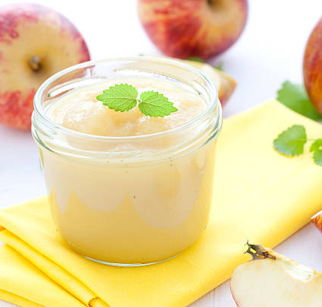
Fruit compote
Traditional, natural and beloved treat will make the yogurt
Reasony Why
Attracting consumer attention with popular taste profiles from other food categories.
Using cross-category inspirations to uplift consumer liking und spur consumer interest.
Ideal for seasonal or limited-time offerings.
Addressing younger target groups (young adults and kids).
Dairy & Plant-based indulgence.
Product Value
We are using our all-in-one solutions to create authentic and well-rounded taste profiles – based on fruit- and non-fruit preparations.
OUR SOLUTIONS
Ingredient Systems & Natural Taste Solutions: Fruit- & Non-Fruit Preparations, Natural Flavours
Cereals, Nuts & Pulses:
Plant-based Ingredients and Bases

Slide 6
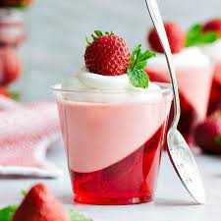
Company
FORCES
CHALLENGES
Exiting from texture and taste
Adjustment of production process is required
SOLUTIONS PROPOSEES
with
I love Jelly! Spoonable yogurt/fresh cheese with the layer of jelly on the bottom.
TIME TO MARKET
Sales model
Long
B2B
Fresh and juicy springy layer of fruit jelly will bring new and exiting sensation to dairy treat
Implementation costs
Facilite d’implementation
Investment to the adjustment of production process
Ingredients are known and used in dairy
Production solution
Economical performance
SUPPORT DE PRESENTATION CREATIVITY DAY
Sales
Présentation: Y Prototypes/Maquettes: Y

Slide 7

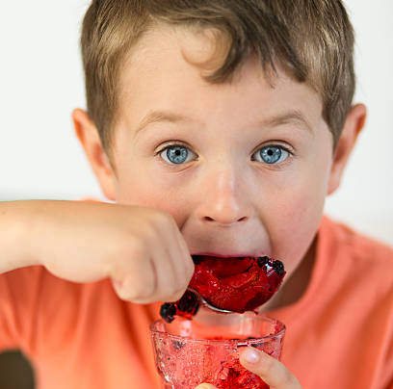
Indulgent product concepts for dairy & plant-based drinks – inspired by delicious baked goods
I love Jelly
Reasony Why
Attracting consumer attention with popular taste profiles from other food categories.
Using cross-category inspirations to uplift consumer liking und spur consumer interest.
Ideal for seasonal or limited-time offerings.
Addressing younger target groups (young adults and kids).
Dairy & Plant-based indulgence.
Product Value
We are using our all-in-one solutions to create authentic and well-rounded taste profiles – based on fruit- and non-fruit preparations.
OUR SOLUTIONS
Ingredient Systems & Natural Taste Solutions: Fruit- & Non-Fruit Preparations, Natural Flavours
Cereals, Nuts & Pulses:
Plant-based Ingredients and Bases

Slide 8
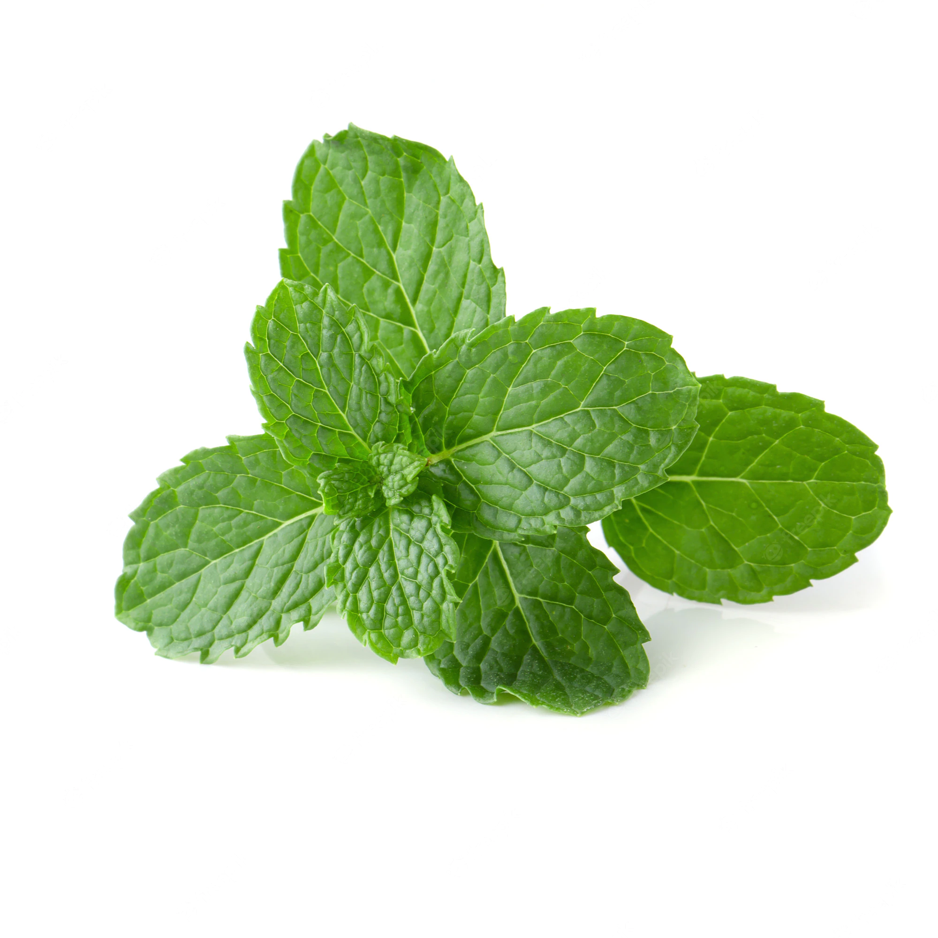
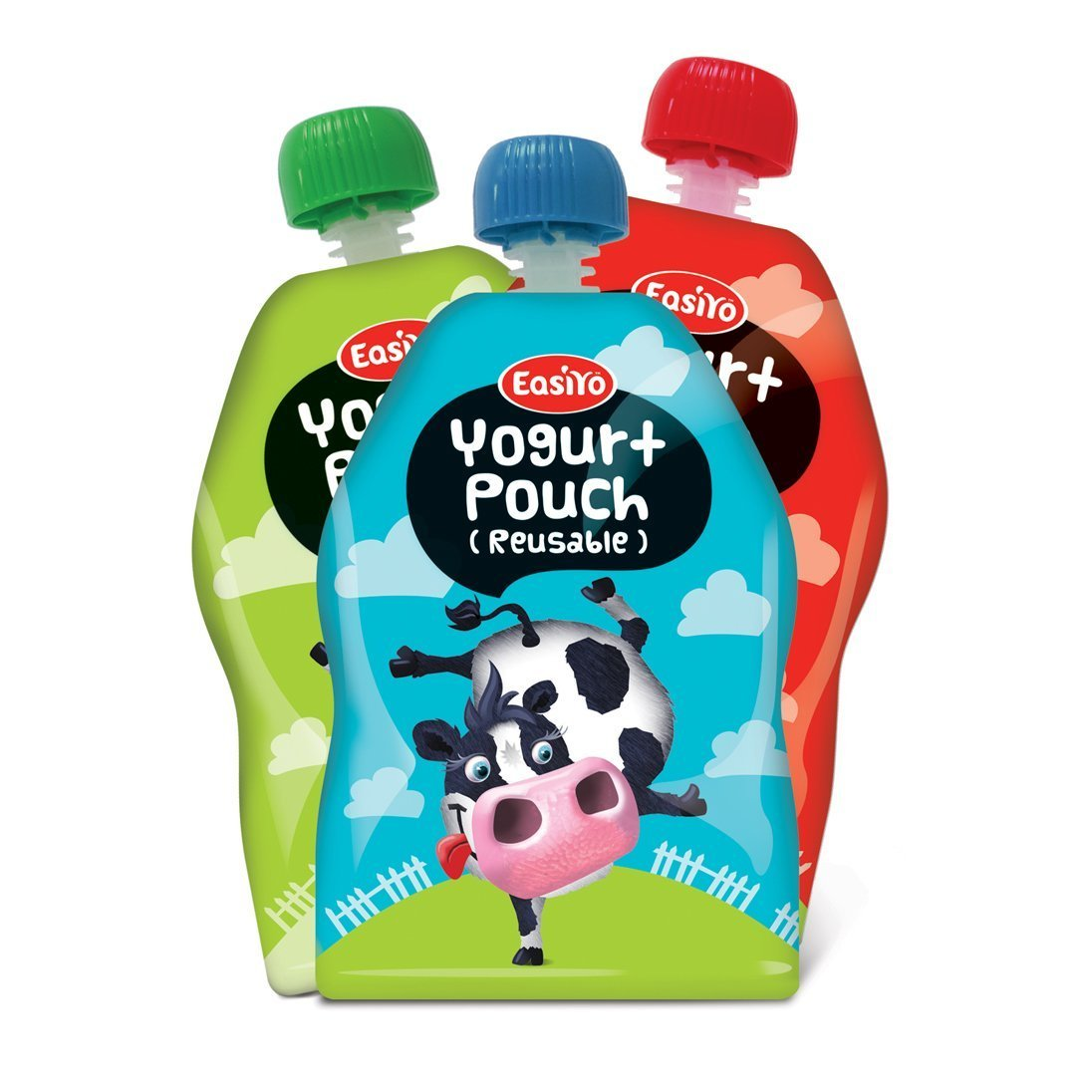
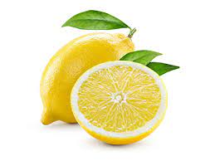
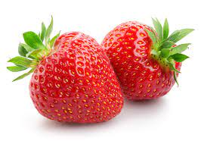
Company
FORCES
CHALLENGES
Clean label, natural flavours/colors, no sugar added - optional
There is no special adjustment required.
SOLUTIONS PROPOSEES
with
Sensational! The range of drinkable yogurts/poach packed developed to provide the tastes sensations coming not from smell but from tasting buds.
TIME TO MARKET
Sales model
Short
B2B
Sweet, sour and cooling effects supported by paired taste will entertain kids and will turn the consumption process into adventure
Implementation costs
Facilite d’implementation
Usage of packing equipment of Petit Filous
Ingredients are known and used in dairy
Production solution
Economical performance
SUPPORT DE PRESENTATION CREATIVITY DAY
Sales
Présentation: Y Prototypes/Maquettes: Y

Slide 9
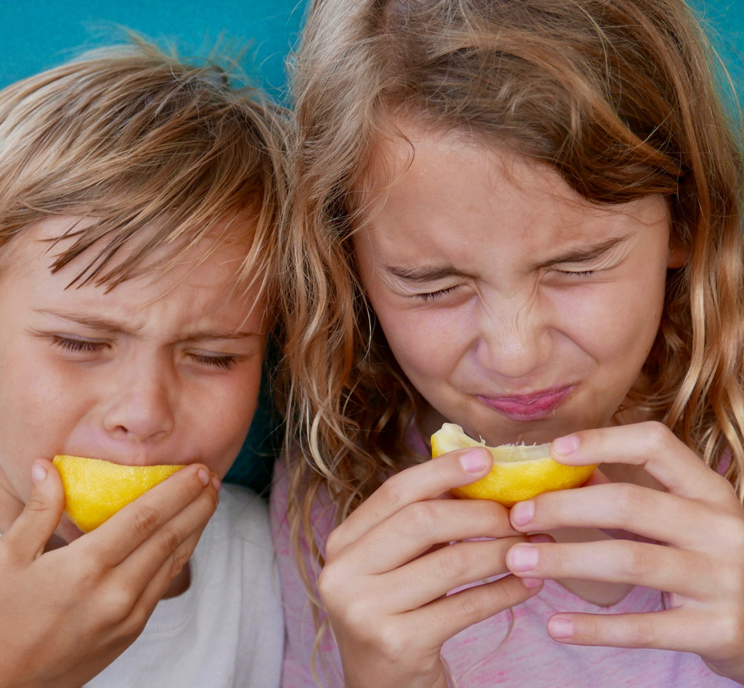

Indulgent product concepts for dairy & plant-based drinks – inspired by delicious baked goods
Sensational!
Reasony Why
Attracting consumer attention with popular taste profiles from other food categories.
Using cross-category inspirations to uplift consumer liking und spur consumer interest.
Ideal for seasonal or limited-time offerings.
Addressing younger target groups (young adults and kids).
Dairy & Plant-based indulgence.
Product Value
We are using our all-in-one solutions to create authentic and well-rounded taste profiles – based on fruit- and non-fruit preparations.
OUR SOLUTIONS
Ingredient Systems & Natural Taste Solutions: Fruit- & Non-Fruit Preparations, Natural Flavours
Cereals, Nuts & Pulses:
Plant-based Ingredients and Bases

